Slide 1
CMARC and CMHRP Updates
Tonya Dennis, MSW, LCSW
Care Management for High-Risk Pregnancies Program Manager
Maternal Health Branch- Women, Infant and Community Wellness Section
Division of Public Health- North Carolina Department of Health and Human Services
Gail Lamb
Interim CMARC Program Manager
School, Adolescent, and Child Health Unit
Whole Child Health Section
Division of Child and Family Well-Being
June 2024

Slide 2

Notes:
Gail and Tonya talk about programs working together

Slide 3
Access to NC Tracks for CMHRP and CMARC Care Managers
DPH and DCFW are asking the health directors to allow CMHRP and CMARC Care Managers (CMs) access to NC Tracks to improve their ability to assist in navigation of member service delivery.
NC Tracks is the "source of truth" for the member's health plan assignment and allows CMs to verify Medicaid eligibility, identify tailored plan eligibility and access other important pieces of information to assist with care management service delivery, such as accessing plan value added benefits.
We would like for health directors to encourage their Office Administrators (OAs) to collaborate with the CM supervisors to determine who needs access (preferably all CMs) and work to grant that access using the information DHB has provided (refer to next slide).
Notes:
Tonya cover this slide?

Slide 4
Access to NC Tracks for CMHRP and CMARC Care Managers (cont.)
All Local Health Departments enrolled in NCTracks with an NPI have an Office Administrator (OA). The OA of each LHD has the ability to assign permissions for LHD employees that need to access information on NCTracks Provider Portal. LHD CMHRP/CMARC care managers that require NCTracks access can reach out to the OA to give permission for the Recipient Eligibility Verification function of NCTracks to verify member eligibility. The OA can assign user roles to as many as needed.
See https://www.nctracks.nc.gov/content/public/providers/provider-communications/2022-Announcements0/Reminder-of-User-Types-and-Roles-in-NCTracks.html for more information about user roles in NCTracks.
Notes:
Gail cover this slide?

Slide 5
CMARC Referral and Supervisor Directory
List of primary and secondary contacts for each county that is updated monthly
Directory can be found on the Medicaid CMARC Web Page
Notes:
Gail then goes

Slide 6
CMARC Updates
CMARC information and regular updates are provided in the North Carolina Association of Public Health Nurse Administrators (NCAPHNA) Quarterly Report
Next NCAPHNA Quarterly Report will be released in July 2024

Slide 7
CMARC Training Components
Phase One- CMARC Care Management Basics
Phase One Plus- Supports the work of CMARC
Phase Two- Target Populations
Phase Three- Supervisor Expectations
Seasoned Staff are encouraged to use as a Refresher

Slide 8
Bimonthly CMARC Program Webinars
July 11, 2024
September 12, 2024
November 14, 2024
Care Managers can access the live and archived webinars on the CMARC Web Page

Slide 9
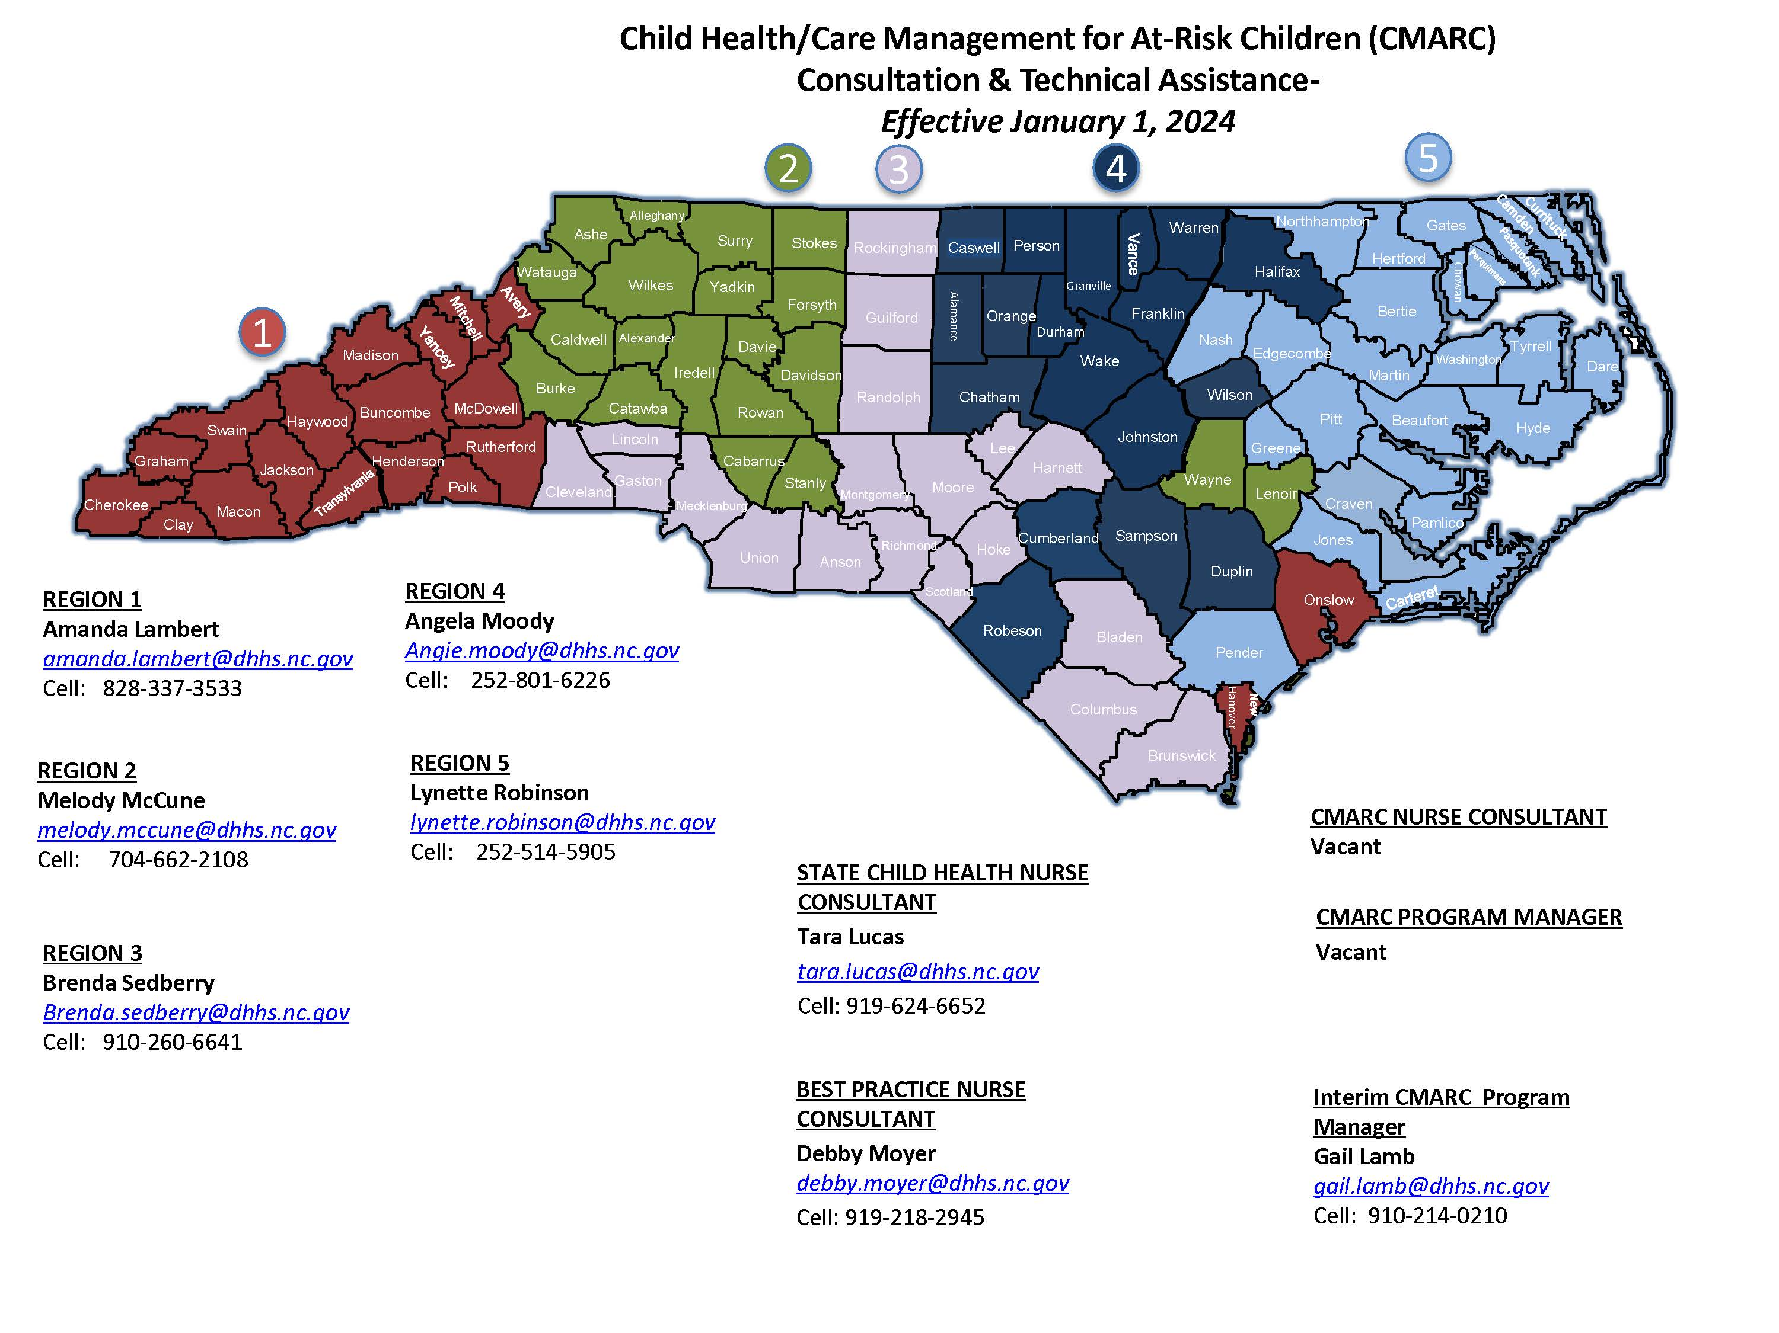
Child Health/CMARC Statewide Coverage Map
LHDs have the support of your state CMARC Program staff and your regional child health nurse consultants (RCHNCs) who serve as resources for both the Child Health and CMARC Programs.
All RCHNCs have been and will continue to contact each LHD to offer support.
Please reach out to your RCHNC for questions about CMARC.
Notes:
Map was updated in Jan 2024 – Ginger has gone on to other opportunities

Slide 10
Temporary Coverage Plan CMARC (and Child Health): 4/24/24 thru 7/26/24 for Lynette Robinson's Region
Tara Lucas (CH) & Gail Lamb (CMARC) – ARHS District, MTW District, Dare, Pamlico, and Hyde
tara.lucas@dhhs.nc.gov gail.lamb@dhhs.nc.gov
(919) 624-6652 (910) 214-0210
Angie Moody – Edgecombe, Nash
angie.moody@dhhs.nc.gov
(252) 801-6226
Amanda Lambert – Jones, Carteret, Northampton
amanda.lambert@dhhs.nc.gov
(828) 337-3533
Brenda Sedberry – Beaufort, Pender
brenda.sedberry@dhhs.nc.gov
(910) 260-6641
Melody McCune – Pitt, Greene, Craven
melody.mccune@dhhs.nc.gov
704-662-2108

Slide 11
CMHRP Updates
Quarterly Statewide Training Webinar released on June 12
  Webinar topics included:
    Medicaid Expansion update
    Tailored Plans update
    Maternal Mental Health Report Card
    2022 Infant Mortality rates
    CM tools for navigating CI reports to manage caseloads
    CMHRP Program updates and reminders
      Info on rise in Pertussis
      Documentation
    Program Resources
      Maternal Mental Pathway and others
    CM success stories and other local celebrations!

Slide 12
CMHRP Updates
Bi-monthly Program Update will be released on June 21
"Newsletter style" program update will contain info on:
  Medicaid Managed Care
  Documentation guidance
  Reiteration of important highlights from the June webinar
  Updates to program guidance documents
  Update on advocacy regarding the recent "closing the loop" barrier
  Training opportunities

Slide 13
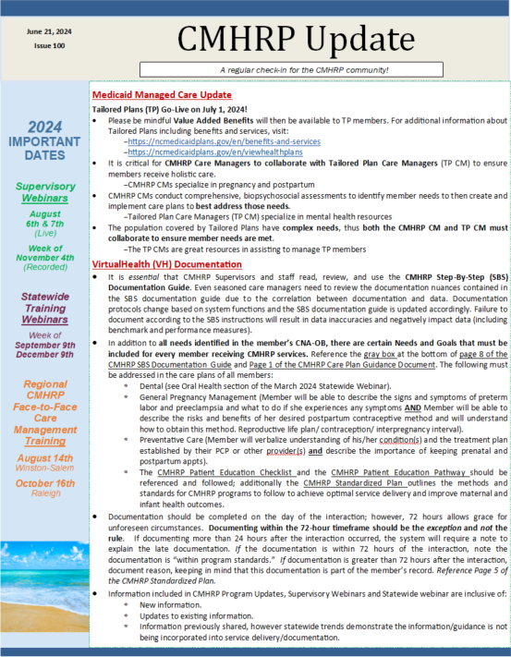
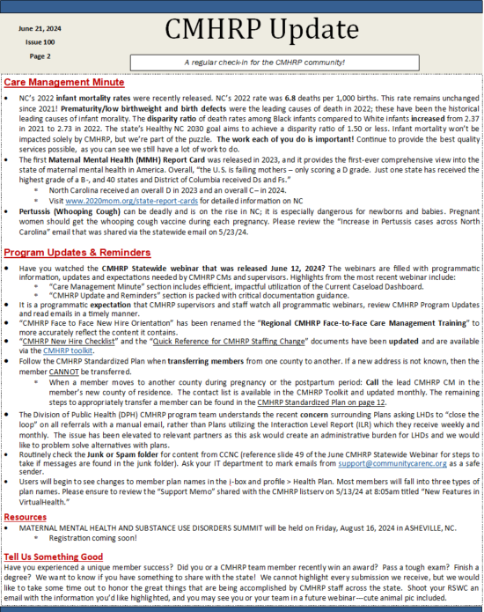
Notes:
Example of both pages

Slide 14
2024 CMHRP Calendar
Regional Face-to-Face CMHRP Care Management Training
March 20, 2024, Winston-Salem
May 8, 2024, Raleigh
August 14, 2024, Winston-Salem
October 16, 2024, Raleigh
CMHRP Statewide Webinars
Recording released the week of March 11, 2024
Recording released the week of June 10, 2024
Recording released the week of September 9, 2024
Recording released the week of December 9, 2024
CMHRP Supervisory Webinars
LIVE webinar February 6 and 7, 2024
Recording released the week of May 13, 2024
LIVE webinar August 6 and 7, 2024
Recording released the week of November 4, 2024

Slide 15
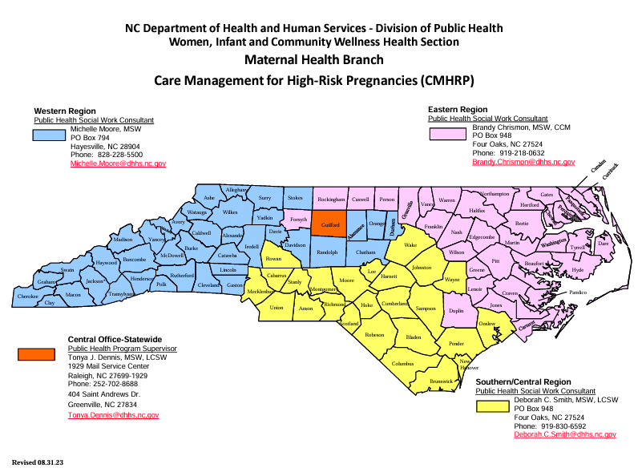
CMHRP Statewide Coverage Map

