Slide 1

NCALHDs Partners Committee Meeting
June 19, 2024

Slide 2

A statewide effort to support people with behavioral health conditions, intellectual or developmental disabilities (IDD), and traumatic brain injuries (TBI) in becoming tobacco free, by working with service providers to integrate tobacco use treatment and take campuses tobacco free. https://breatheeasync.org/
A coalition of behavioral health, healthcare & disability service organizations working to implement a best-practice, tobacco-free culture of care. Learn more.

Slide 3

The odds are stacked against people with behavioral health conditions trying to quit
One study found people who have a serious mental illness are twice as likely to live in a neighborhood with high numbers of tobacco retailers and high levels of advertising.⁵
Studies estimate between 5-15% of people in substance use treatment started to smoke in treatment.⁶⁻⁹
People with behavioral health conditions can and do quit but may need longer and more intensive treatment to quit for good.¹¹
Behavioral health services that offer evidence-based treatment in a tobacco-free environment are hard to find in North Carolina.¹²⁻¹³
An estimated 50% of all people who receive substance use treatment will die due to tobacco-related illness.¹⁰
50%
In the U.S., a person who has a behavioral health condition and smokes loses 25 years of life on average.¹
Notes:
Dr. Tilson: we have strong evidence that this is an area where there are serious inequities and disparities.
I will highlight a few of them to share with you WHY as our DHHS Medical Officers all agree, we must take action, the time is now.
1. Prochaska JJ, Das S, Young-Wolff KC. Smoking, Mental Illness, and Public Health. Annual Review of Public Health [Internet]. 2017 Mar 20 [cited 2021 May 18];38:165–85. Available from: https://pubmed.ncbi.nlm.nih.gov/27992725/
2. U.S. Department of Health and Human Services. Smoking Cessation: A Report of the Surgeon General. Atlanta, GA; 2020.
3. Prochaska JJ, Delucchi K, Hall SM. A meta-analysis of smoking cessation interventions with individuals in substance abuse treatment or recovery. Journal of Consulting and Clinical Psychology [Internet]. 2004 Dec [cited 2021 May 18];72(6):1144–56. Available from: https://pubmed.ncbi.nlm.nih.gov/15612860/
4. Taylor G, McNeill A, Girling A, Farley A, Lindson-Hawley N, Aveyard P. Change in mental health after smoking cessation: Systematic review and meta-analysis. BMJ (Online) [Internet]. 2014 Feb 13 [cited 2021 May 18];348. Available from: http://www.bmj.com/content/348/bmj.g1151?tab=related#datasupp
5. Young-Wolff KC, Henriksen L, Delucchi K, Prochaska JJ. Tobacco retailer proximity and density and nicotine dependence among smokers with serious mental illness. Am J Public Health. 2014 Aug;104(8):1454-63. doi: 10.2105/AJPH.2014.301917. Epub 2014 Jun 12. PMID: 24922145; PMCID: PMC4103201.
6. Kohn CS, Tsoh JY, Weisner CM. Changes in smoking status among substance abusers: Baseline characteristics and abstinence from alcohol and drugs at 12-month follow-up. Drug and Alcohol Dependence [Internet]. 2003 Jan 24 [cited 2021 May 19];69(1):61–71. Available from: https://pubmed.ncbi.nlm.nih.gov/12536067/
7. Friend KB, Pagano ME. Smoking initiation among nonsmokers during and following treatment for alcohol use disorders. Journal of Substance Abuse Treatment [Internet]. 2004 Apr [cited 2021 May 19];26(3):219–24. Available from: /pmc/articles/PMC3272765/
8. Weinberger AH, Platt J, Esan H, Galea S, Erlich D, Goodwin RD. Cigarette smoking is associated with increased risk of substance use disorder relapse: A nationally representative, prospective longitudinal investigation. Journal of Clinical Psychiatry [Internet]. 2017 Feb 1 [cited 2021 May 19];78(2):e152–60. Available from: /pmc/articles/PMC5800400/
9. de Dios MA, Vaughan EL, Stanton CA, Niaura R. Adolescent tobacco use and substance abuse treatment outcomes. Journal of Substance Abuse Treatment [Internet]. 2009 Jul [cited 2021 May 19];37(1):17–24. Available from: /pmc/articles/PMC2735078/
10. Bandiera FC, Anteneh B, Le T, Delucchi K, Guydish J. Tobacco-related mortality among persons with mental health and substance abuse problems. PLoS ONE [Internet]. 2015 Mar 25 [cited 2021 May 19];10(3):e0120581. Available from: https://journals.plos.org/plosone/article?id=10.1371/journal.pone.0120581
11. US Department of Health and Human Services. Treating Tobacco Use and Dependence: 2008 Update [Internet]. Rockville, MD: US Department of Health and Human Services; 2008 [cited 2021 Jun 15]. Available from: https://www.ncbi.nlm.nih.gov/books/NBK63952/
12. Substance Abuse and Mental Health Services Administration, National Mental Health Services Survey (N-MHSS): 2020. Data on Mental Health Treatment Facilities. Rockville, MD: Substance Abuse and Mental Health Services Administration, 2021.
13. Substance Abuse and Mental Health Services Administration, National Survey of Substance Abuse Treatment Services (N-SSATS): 2020. Data on Substance Abuse Treatment Facilities. Rockville, MD: Substance Abuse and Mental Health Services Administration, 2021.
14. North Carolina Department of Health and Human Services. Report on the Pilot to Establish a Tobacco Free Environment in State Operated Healthcare Facilities: Broughton Hospital and Walter B. Jones ADATC. 2011.

Slide 4

Nicotine Addiction Is a Source of Stress
When a person is dependent on nicotine and stops using it, their body and brain must readjust to not having nicotine.
This can result in temporary symptoms of nicotine withdrawal.
Nicotine withdrawal symptoms include irritability, restlessness, feeling anxious or depressed, trouble sleeping, problems concentrating, and craving nicotine.
Youth may turn to vaping to try to deal with stress or anxiety, creating a cycle of nicotine dependence. But nicotine addiction can be a source of stress.

Slide 5


We can double North Carolinians’ chances of quitting.
Providing a combination of FDA-approved medications and counseling in a tobacco-free environment doubles a person’s chances of quitting for good²
You don't have to do this alone!
Tobacco prevention staff are here to help!
Read more at breatheeasync.org
Notes:
1. Prochaska JJ, Das S, Young-Wolff KC. Smoking, Mental Illness, and Public Health. Annual Review of Public Health [Internet]. 2017 Mar 20 [cited 2021 May 18];38:165–85. Available from: https://pubmed.ncbi.nlm.nih.gov/27992725/
2. U.S. Department of Health and Human Services. Smoking Cessation: A Report of the Surgeon General. Atlanta, GA; 2020.
3. Prochaska JJ, Delucchi K, Hall SM. A meta-analysis of smoking cessation interventions with individuals in substance abuse treatment or recovery. Journal of Consulting and Clinical Psychology [Internet]. 2004 Dec [cited 2021 May 18];72(6):1144–56. Available from: https://pubmed.ncbi.nlm.nih.gov/15612860/
4. Taylor G, McNeill A, Girling A, Farley A, Lindson-Hawley N, Aveyard P. Change in mental health after smoking cessation: Systematic review and meta-analysis. BMJ (Online) [Internet]. 2014 Feb 13 [cited 2021 May 18];348. Available from: http://www.bmj.com/content/348/bmj.g1151?tab=related#datasupp
5. Young-Wolff KC, Henriksen L, Delucchi K, Prochaska JJ. Tobacco retailer proximity and density and nicotine dependence among smokers with serious mental illness. Am J Public Health. 2014 Aug;104(8):1454-63. doi: 10.2105/AJPH.2014.301917. Epub 2014 Jun 12. PMID: 24922145; PMCID: PMC4103201.
6. Kohn CS, Tsoh JY, Weisner CM. Changes in smoking status among substance abusers: Baseline characteristics and abstinence from alcohol and drugs at 12-month follow-up. Drug and Alcohol Dependence [Internet]. 2003 Jan 24 [cited 2021 May 19];69(1):61–71. Available from: https://pubmed.ncbi.nlm.nih.gov/12536067/
7. Friend KB, Pagano ME. Smoking initiation among nonsmokers during and following treatment for alcohol use disorders. Journal of Substance Abuse Treatment [Internet]. 2004 Apr [cited 2021 May 19];26(3):219–24. Available from: /pmc/articles/PMC3272765/
8. Weinberger AH, Platt J, Esan H, Galea S, Erlich D, Goodwin RD. Cigarette smoking is associated with increased risk of substance use disorder relapse: A nationally representative, prospective longitudinal investigation. Journal of Clinical Psychiatry [Internet]. 2017 Feb 1 [cited 2021 May 19];78(2):e152–60. Available from: /pmc/articles/PMC5800400/
9. de Dios MA, Vaughan EL, Stanton CA, Niaura R. Adolescent tobacco use and substance abuse treatment outcomes. Journal of Substance Abuse Treatment [Internet]. 2009 Jul [cited 2021 May 19];37(1):17–24. Available from: /pmc/articles/PMC2735078/
10. Bandiera FC, Anteneh B, Le T, Delucchi K, Guydish J. Tobacco-related mortality among persons with mental health and substance abuse problems. PLoS ONE [Internet]. 2015 Mar 25 [cited 2021 May 19];10(3):e0120581. Available from: https://journals.plos.org/plosone/article?id=10.1371/journal.pone.0120581
11. US Department of Health and Human Services. Treating Tobacco Use and Dependence: 2008 Update [Internet]. Rockville, MD: US Department of Health and Human Services; 2008 [cited 2021 Jun 15]. Available from: https://www.ncbi.nlm.nih.gov/books/NBK63952/
12. Substance Abuse and Mental Health Services Administration, National Mental Health Services Survey (N-MHSS): 2020. Data on Mental Health Treatment Facilities. Rockville, MD: Substance Abuse and Mental Health Services Administration, 2021.
13. Substance Abuse and Mental Health Services Administration, National Survey of Substance Abuse Treatment Services (N-SSATS): 2020. Data on Substance Abuse Treatment Facilities. Rockville, MD: Substance Abuse and Mental Health Services Administration, 2021.
14. North Carolina Department of Health and Human Services. Report on the Pilot to Establish a Tobacco Free Environment in State Operated Healthcare Facilities: Broughton Hospital and Walter B. Jones ADATC. 2011.

Slide 6
Level Setting
What is the Medicaid Policy?
To Whom does it Apply/Not Apply?
Notes:
Dr Keith McCoy introduces self and asks Steph, Joyce and Anna to do so as well.

Slide 7
North Carolina Tobacco-Free Policy Requirement
    Goes into effect July 1, 2024.
    Requirements are outlined in the most recent Medicaid Bulletin from March 21, 2024. This is the appropriate resource for policy implementation guidance and supersedes previous bulletins on the topic.
    Please make the connections and share this bulletin with your counterparts in your Local Social Services.

Slide 8
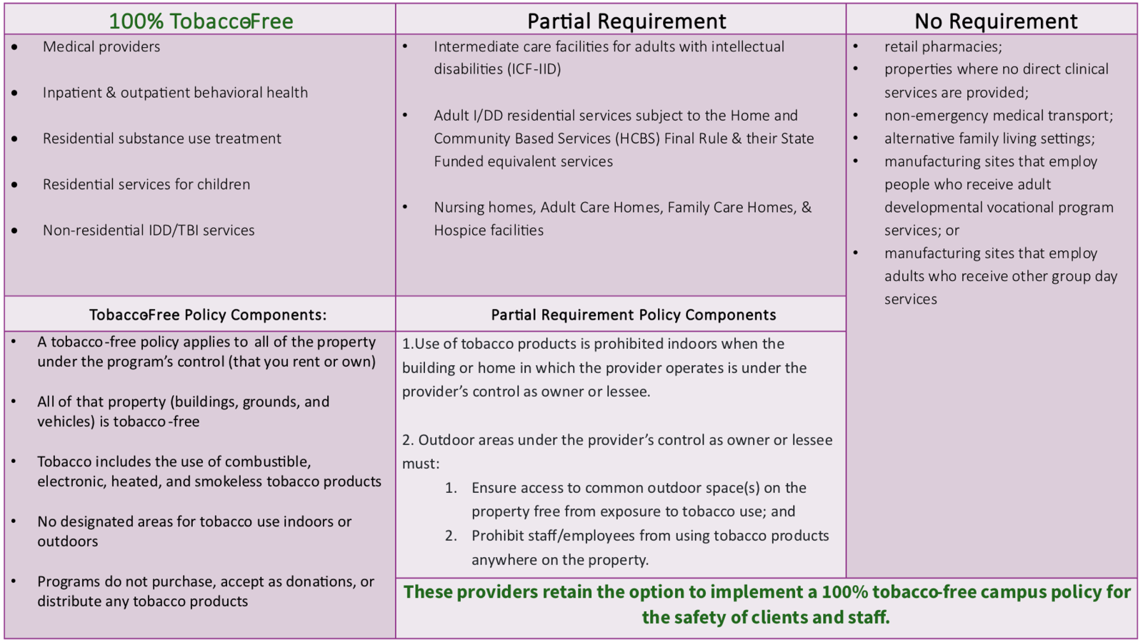

Slide 9











Communications
Prepare the Environment
Quitline NC
Clinical Processes
Evaluation
Communications
Staff Training
Communications
Develop & Adopt TF Policy
Make the Case - Build Support
Communications
STARTING POINT
Communications
Tobacco-Free
Organization Road Map
Customize to fit your needs

Slide 10
We are rolling on the road to a healthier NC
Breathe Easy NC started in 2011 when up to 40% of people with mental health and substance use disorders in NC smoked.
Between 2016 (when data was first collected) and 2022, the number of facilities offering tobacco screening and treatment to clients increased by over 60%.
Between 2016 and 2022 the percentage of North Carolina substance use disorder facilities with a smoke-free campus policy also increased by over 60%, with most of the increase occurring between 2020 and 2022.
As of 2022, the percentage of people with mental health and substance use disorders who smoke in NC has decreased to 29%.

Slide 11


Congratulations!
All Local Health Departments (except two) are now compliant except for two with the Medicaid Tobacco-free policy!
We are working with these 2 LHDs to get them across the finish line.
Great way to show public health leadership! #weareNCpublichealth

Slide 12
Seeking Compliance First with Training and Technical Assistance
Provider monitoring for compliance with the tobacco-free requirement will occur through a grievance/complaint process.
Patients, family, or staff may file grievances with the appropriate health plan following their standard filing process. The health plan then forwards the tobacco-related grievance to the NCDHHS Tobacco Prevention and Control Branch via this email address: tf_concerns@dhhs.nc.gov
NCDHHS will monitor for any complaints related to noncompliance with this policy. Our goal is to support facilities with training and technical assistance if needed. More information is described in the March 21, 2024 Medicaid Bulletin.
The NCDHHS preferred approach is to provide and encourage training and technical assistance to assist providers with compliance.

Slide 13
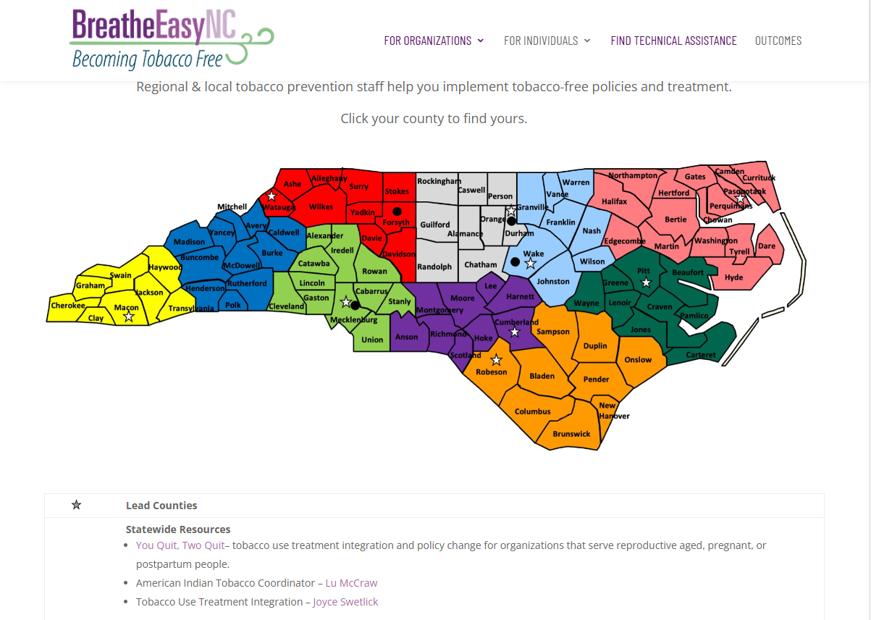
Your Regional Tobacco Control Infrastructure
Working to advance health equity by identifying and eliminating commercial tobacco product-related inequities and disparities.
How can Local Health Directors support this work further?
Consider maintaining a stock of nicotine replacement therapy – patches, gum/lozenges – which are safe and effective OTC medication – to assist agencies and their staff/clients with compliance.

Slide 14

Questions?
Comments?

Slide 15
Some additional resources

Slide 16
Recommendations for Implementation
Consider developing a comprehensive tobacco-free policy that clearly outlines the rules and expectations regarding tobacco use on company premises.
Involve employees in the development process to gain their input and support. This can help foster a sense of ownership and increase compliance.
Communicate the policy to all employees through multiple channels, such as email, company meetings, posters, and employee handbooks.
Establish clear enforcement procedures and consequences for violating the tobacco-free policy. Consistently enforce these procedures to demonstrate the organization's commitment to maintaining a safe and healthy tobacco-free environment.
Many companies have successfully worked to promote normative change by placing positively worded tobacco-free signage on the grounds in key visible locations for visitors. This is likely all that is needed to reach compliance, especially if communicated respectfully with an understanding of why this is important in a health facility.

Slide 17



Make the Case – Build Support | Develop & Adopt Tobacco-Free Policy | Staff Training | Clinical Processes (Tobacco Treatment)
Leadership buy-in Staff buy-in Stakeholder buy-in Organizational assessment Survey staff Identify champions Form interdisciplinary “wellness” committee Utilize TF Roadmap Checklist to track efforts | Adopt TF Campus Policy Define “tobacco” Align Human Resources Policy Ensure employee health plan includes quit services Ensure all staff are aware of policy, timeframe Inform agency neighbors of TF Policy | Educate all staff – does everyone know the WHY? Clinical staff: best practice tobacco treatment Internal/External tobacco treatment (and related) referral sources Adopt protocol for sustainable staff training | 5-As integration (similar to SBIRT) Establish protocol for clinical workflow Build prompts into Electronic Health Record (EHR) Guidance available-Million Hearts Tobacco Cessation Change Package Cessation billing -Guidance available from ALA
“Begin with the end in mind” ~Stephen Covey

Slide 18
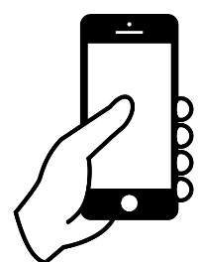


QuitlineNC | Messaging and Communications Important part of every step along the journey | Prepare the Environment | Evaluation (How do we know how we are doing? / Quality improvement)
Register as referral site; refer; receive outcomes reports QLNC: Behavioral health protocol – free NRT Proactive referrals via fax, secure email, web portal Texting feature Young adult quitting vaping program – Live Vape Free | Staff targeted messaging Client facing - motivational Tobacco education Policy cards Prominent campus signage Posters, banners Motivational cards Website messages | Install internal & external signage Repurpose smoking areas to wellness theme Remove ashtrays and thoroughly clean Healthy socialization spaces and activities Fresh Air Breaks Launch Event | Survey staff & clients (initial & at intervals) Track EHR tobacco data: what can you measure? Track # clients who receive quit RX and interventions Assess staff training needs & knowledge of WHY (repeat) Sustainability beyond initial implementation
Whole Person Care. Tobacco-Free Supports Recovery. Quitting is a Journey.

Slide 19
Resources: Tobacco-Free Behavioral Health
Breathe Easy NC --- Note the Resource Index for more academic citations and resources
Change for Life: Tobacco Free Recovery (Chaired by Mary Ward, former Executive Director, McLeod Center for Health and Wellness.
National Behavioral Health Network for Tobacco & Cancer Control (NBHN), operated by the National Council for Mental WellBeing.
Infographic: How to Implement a Tobacco-Free Policy
Tobacco-Free Toolkit for Behavioral Health Agencies, SAMHSA (tobaccofreerecovery.org)
Tobacco-Free Toolkits for Behavioral Health Agencies, California
A Toolkit to Address Tobacco Use in Behavioral Health Settings, American Lung Association, Minnesota
Dimensions Tobacco-Free Toolkit, University of Colorado Anschutz School of Medicine
Taking Texas Tobacco-Free
Tobacco Use and Quitting Among Individuals with Behavioral Health Conditions, CDC

