Slide 1
Bernard Allen Program’s PFAS Treatment System Reimbursement Program
Vincent Antrilli, Program Supervisor
June 7, 2024

Slide 2
NC Statute: 87-98
Established 2007
Perform well sampling
Provide alternative drinking water supplies
  Bottled Water
  Treatment Systems
  Water Service Connections
Treatment System Maintenance
Qualifications
Contamination above drinking water standards
Financial Qualification
  Less than 3x Poverty Level
No Business or Corp
Didn’t Cause Contamination
Not Naturally Occurring
Department of Environmental Quality

Slide 3
NC Statute: 87-98 Modification
In 2022 G.S. 87-98 was modified to include provisions for PFAS.
  No income limit
  Contamination limits expanded to include DHHS health goal and EPA’s proposed health advisory standards for contaminants without MCL or 2L standards
Basis for Determining Treatment Needs
  PFOA 4.0 ng/L
  PFOS 4.0 ng/L
  PFNA 10 ng/L
  PFHxS 10 ug/L
  HFPO-DA 10 ug/L
  A mixture of two or more HFPO-DA, PFBS, PFHXS, PFNA at hazard index of 1.0
Eligibility
  PFAS Exceedance according to Basis for Determining Treatment Needs
  Treatment system purchased and installed after Nov 2019
Department of Environmental Quality

Slide 4
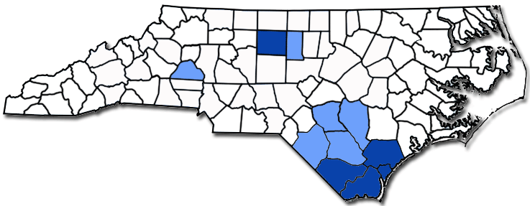
PFAS Treatment System Reimbursement Program
Current Program Areas
= Initial Pilot Program Areas
= Program Expansion Areas
Department of Environmental Quality

Slide 5
PFAS Treatment System Reimbursement Program
Funding
Limited nonrecurring funding
Tiered approach to reimbursement
  Treatment System Options
  Income Level
Treatment System Options
  Group A:
    Point-of-entry whole house GAC or RO
    Point-of-use Kinetico K-5
  Group B: Point-of-use RO
  Group C: Point-of-use dual chamber carbon
Treatment System Payout Chart |  | Treatment System Group
 |  | A | B | C
Income Range | 1 | $ 3,000 | $ 700 | $ 500
 | 2 | $ 2,250 | $ 525 | $ 375
 | 3 | $ 1,500 | $ 350 | $ 250
Income Level
  Range 1 (up to 2x Poverty Level)
  Range 2 (2x to 4x Poverty Level)
  Range 3 (Above 4x Poverty Level)
Department of Environmental Quality

Slide 6
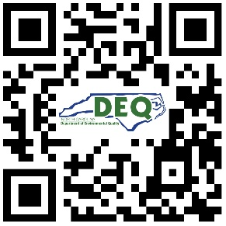
PFAS Treatment System Reimbursement Program
Application Package
Applications are mailed out and can also be accessed online at:
PFAS Treatment System Assistance Program | NC DEQ
Department of Environmental Quality

