Slide 1
Federal PFAS Rule & North Carolina Public Water Systems
June 19, 2024
Rebecca Sadosky, Ph.D.

Slide 2
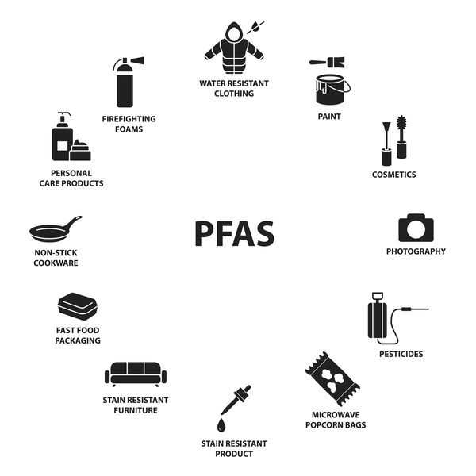

Overview
NC Public Drinking Water Systems Impacted by the PFAS Rule
Timeline of PFAS Rule Development
Final Rule Maximum Contaminant Levels (MCLs) and Hazard Index (HI)
Sample Frequency and Compliance
PFAS Treatment
Key Effective Dates
Health Effect Language
NC Public Water System PFAS Sampling Overview
Implementation Challenges
Department of Environmental Quality Division of Water Resources

Slide 3
NC Public Drinking Water Systems Impacted by the PFAS Rule
All NC Community Water Systems (CWSs) and Non-Transient Non-Community Water Systems (NTNCWSs) with their own source will be affected by the new PFAS rule (April 2024).
Category | Number of Systems
Total Number of Water Systems Affected | 1,958
CWSs | 1,648
NTNCWSs | 310
Groundwater (GW) Systems | 1,789
Surface Water (SW) Systems* | 169
*Includes surface water purchase systems with their own source and Groundwater Under the Direct Influence of Surface Water (GWUDI) systems.
Department of Environmental Quality Division of Water Resources

Slide 4
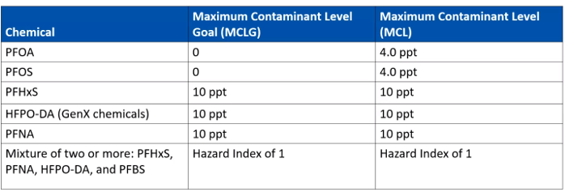
Final Rule MCLs and HI
Five Maximum Contaminants Levels (MCLs) for five individual PFAS and the Hazard Index (HI).
Compliance determined by running annual averages at each entry point.
Department of Environmental Quality Division of Water Resources

Slide 5
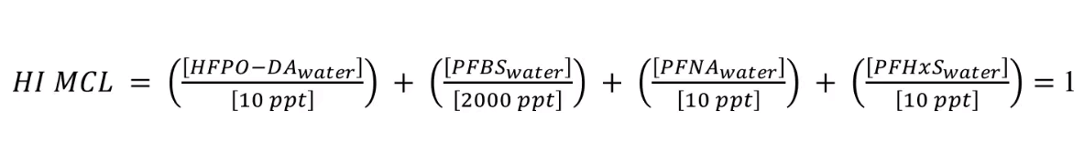
Hazard Index
The Hazard Index (HI) is a long-established approach that the EPA regularly uses, for example in the Superfund program.
To determine the health concerns associated with exposures to chemical mixtures.
It is calculated by adding the ratio of the water sample concentration to a Health Based Water Concentration.
A HI greater than 1 requires a system to take action.
To be considered an exceedance, the HI has to be a mixture of a minimum of two contaminants.
Department of Environmental Quality Division of Water Resources

Slide 6
Approved Methods and Analytical Requirements
EPA Method 533 (Nov. 2019)
  Isotope Dilution Anion Exchange Solid Phase Extraction and Liquid Chromatography/Tandem Mass Spectrometry (LC-MS/MS).
EPA Method 537.1, Version 2.0 (March 2020)
  Solid Phase Extraction and Liquid Chromatography/Tandem Mass Spectrometry (LC/MS/MS).
Department of Environmental Quality Division of Water Resources

Slide 7
PFAS Rule Implementation
Under the final PFAS Rule requirements, a public water system must:
Conduct initial and ongoing compliance monitoring for the six regulated PFAS compounds.
Implement solutions to reduce regulated PFAS in their drinking water if levels exceed the MCLs.
Inform the public of the levels of regulated PFAS measured in their drinking water and if one or more MCLs are exceeded.
Take samples at all entry points to the distribution system.
Sample at an entry point to the distribution system “during periods of representative operating conditions”.
Department of Environmental Quality Division of Water Resources

Slide 8
MCL Calculation and Return to Compliance
MCLs are based on an annual average calculated on a rolling basis (running annual average)
RAA = Q32027 + Q42027 + Q12028 + Q22028
4
Each time a new sample is collected, the system will return to compliance if the newly calculated RAA goes back below the MCL and/or HI.
Department of Environmental Quality Division of Water Resources

Slide 9
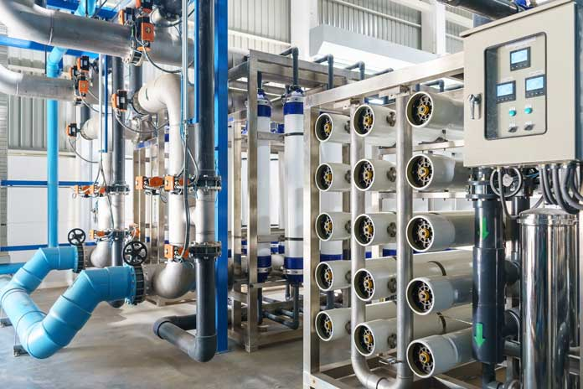
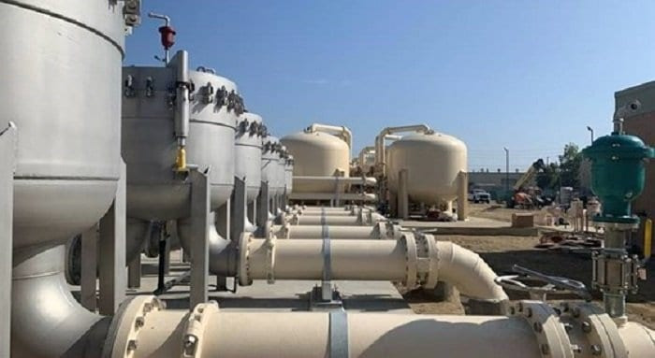
Technologies for PFAS Removal
Public water systems will need to change their source or implement advanced treatment options if their running annual average is above the MCL.
This can potentially happen even before all quarterly samples are collected if the values are high enough to increase the running annual average above the MCL.
The final rule does not set priorities or differentiate between contaminants when it comes to treatment technologies.
Best Available Technologies
Anion exchange
Granular activated carbon (GAC)
Membrane filtration (reverse osmosis and nanofiltration)
Department of Environmental Quality Division of Water Resources

Slide 10
Key PFAS Rule Effective Dates
Requirement | Effective Date
Meet the analytical requirements. (Initial monitoring samples must be collected in accordance with approved methods.) | June 25, 2024
Report the results of initial monitoring to the State | April 26, 2027
Meet the compliance monitoring requirements | April 26, 2027
Consumer confidence report and public notification requirements | April 26, 2027
Meet the MCL compliance requirements | April 26, 2029

Slide 11
Health Effect Language From Final Rule
The Final Rule provides standard health effects language for public notification which includes some differentiation between contaminants.
A few key examples:
“Pregnancy and/or childhood”
  Mentioned for each of the six regulated compounds
“Elevated cholesterol levels”
  Specifically mentioned for PFNA
“Immune, thyroid, and liver effects”
  Specifically mentioned for PFHxS
“Cancer”
  Specifically mentioned for GenX
Department of Environmental Quality Division of Water Resources

Slide 12
NC PWS PFAS Sampling Overview
Sampling Event | Number of Systems | Complete? | Notes
The NC Collaboratory | 376 | Yes | Raw water. 47 analytes. Municipal systems.
Public Water Supply Section 2022 | 50 | Yes | Raw and treated water. One sample/month for three months. 57 analytes.
Public Water Supply Section 2023 | 534 | Yes | Treated water. One sample at one entry point per system. 57 analytes.
Public Water Supply Section 2024 | 255 | No | Treated water. One sample at one entry point per system. 57 analytes. 186 systems sampled as of June 18, 2024.
UCMR5 | 298 | No | Treated water. Multiple samples per system/per entry point. 29 analytes. 177 systems sampled as of May 31, 2024.
Aqua North Carolina, Inc. | 707 | No | Treated water samples only. Data available for six analytes. Received results in April 2024.
Carolina Water Service, Inc. of NC | 96 | ? | 18 analytes. Received results in April 2024.

Slide 13
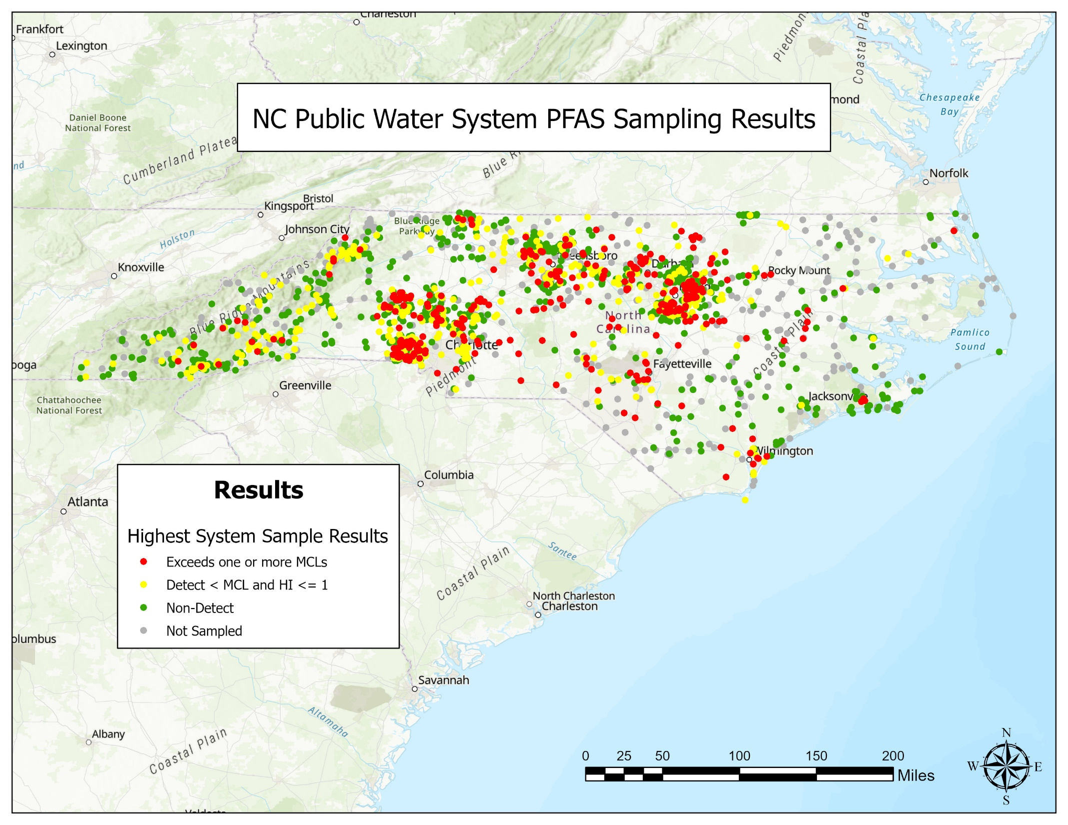
PFAS Sampling Map
All samples reflected are treated water during a snapshot in time. Most are single samples.
Some systems may have since installed treatment or changed their source to be below the MCL.
Department of Environmental Quality Division of Water Resources

Slide 14
General Summary of All NC Data
As of June 18, 2024, based on single sample results, 344 systems (18%) of systems have had at least one result greater than an MCL or HI.
PFOS and PFOA most prominent of the contaminants > MCL.
We are seeing a few exceedances of the HI.
We are finding PFAS other than the six compounds in the proposed regulation.
Department of Environmental Quality Division of Water Resources
Notes:
3.7M people served
95% of that population served by SW but only 15% of systems.

Slide 15
North Carolina Implementation Challenges
Initial Monitoring
  Waiting on additional EPA guidance on what we can accept.
  Will our Federal database automate some of the data evaluation and schedule creation?
>300 water systems may exceed the MCL
  Competing for resources ($ and physical)
Added workload of implementing a new regulation
Department of Environmental Quality Division of Water Resources

Slide 16
Thank You!
Rebecca Sadosky, Ph.D. (Rebecca.Sadosky@deq.nc.gov)
Department of Environmental Quality Division of Water Resources

