Slide 1




Promoting behavioral health equity for North Carolina’s children, youth and families.
The North Carolina
Psychiatry Access Line
(919) 681-2909
NC-PAL is a collaboration between the North Carolina Department of Health and Human Services, Duke’s Department of Psychiatry & Behavioral Sciences and the UNC School of Medicine. For information regarding funding, please see the end slide of this presentation.
Notes:
Started in 2017 as a simple phone line where primary care providers could call and get some guidance when caring for children with mental health concerns. Since then, the word “LINE” has morphed into much, much more!
The goal is still the same – support primary care providers when caring for these dear children and adolescents. But “LINE” now also includes:
Continuing education in the form of mini-fellowships, lunch n learns, practice presentations, and one time consults.

Slide 2



NC-PAL aims to build the mental health knowledge base and capacity of clinical and social service providers in North Carolina to meet the mental health needs of youth and families.
NC-MATTERS, an NC-PAL partner program, supports health care providers in effectively screening, assessing and treating behavioral health concerns in pregnant and postpartum patients.
Both programs are supported by the NC Department of Health and Human Services
Notes:
Based on a national model of Child Psychiatry Access Programs.
I won’t spend a lot of time talking about it here as I don’t think that it is relevant to you, but NC-Matters, one of our partners supports providers caring for pregnant and postpartum patients with mental health or substance use concerns.
So – why NC PAL

Slide 3

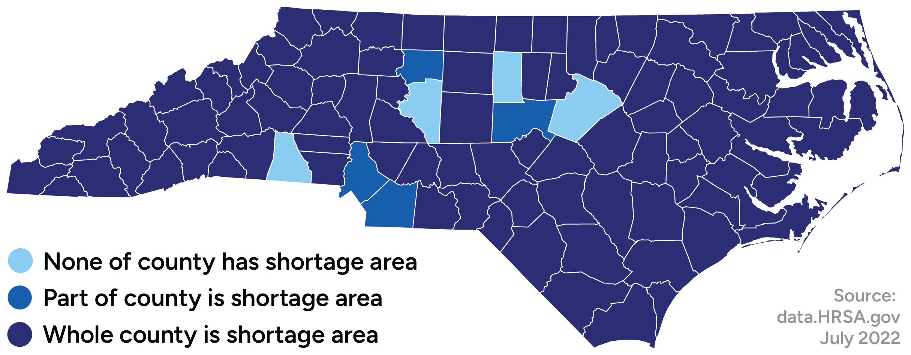
NC Mental Health Professional Shortage
All but 4 counties in North Carolina face a shortage of mental health professionals.
Primary care providers (PCPs) are often the only clinicians available to diagnose and treat pediatric & perinatal mental illness.
Surveys of these clinicians have identified gaps in training and comfort with managing mental health care.
Notes:
NC is the 9th most populous state with ~4,000,000 citizens living in rural regions
80/100 counties are rural
96/100 counties are considered Mental Health Professional Shortage Areas

Slide 4
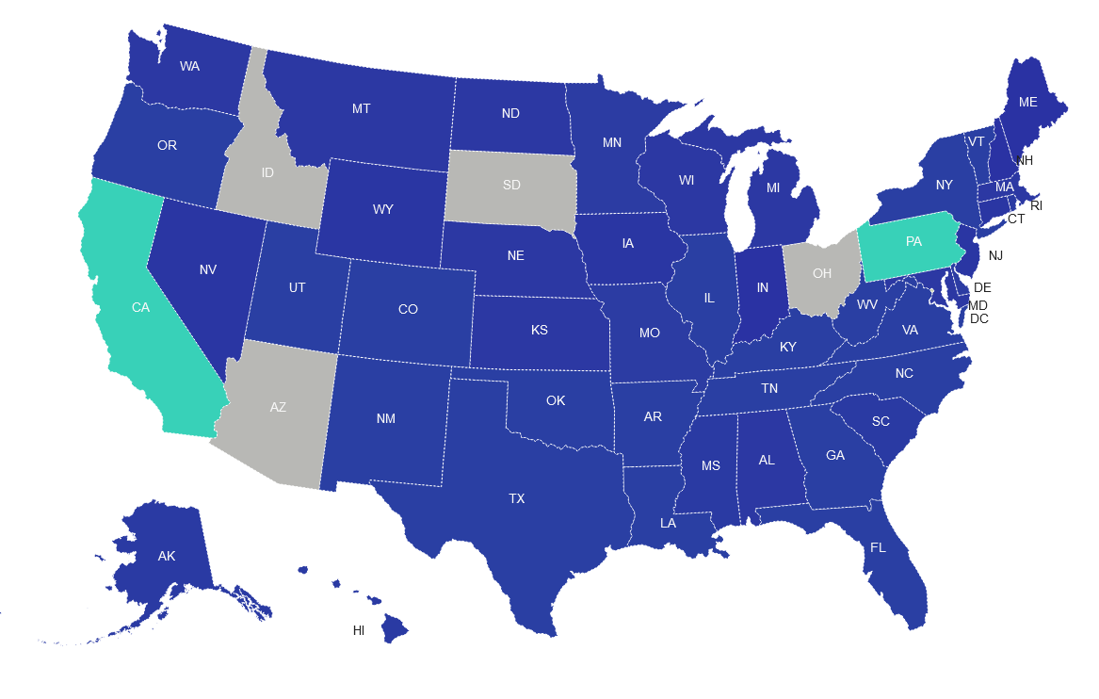



National Network of Child
Psychiatry Access Programs (NNCPAP)
https://nncpap.org/map March 2023
Notes:
The neat thing is, this is a national coordinated effort! Both state and national funding is helping to support this across the country. States linked to each other through national network, constantly learning from one another via a BaseCamp site, mailing lists, and conference meetings). In Texas is is call CPAN(child psychiatry network) in VA its called the VMAP (virginia mental health access program).
The states receiving HRSA funding are further connected through similar formats.
As you can see in this graphic there are only 10 states not currently developing or operating a Child Psychiatry Access Program.

Slide 5



NC-PAL provides primary care clinicians with support for mental and behavioral health screening, assessment, and treatment for their pediatric patients.
Real-time Consultation
Clinical consultation and referral support
via NC-PAL phone line
Practice Presentations
Virtual and in-person presentations on
topics relevant to your practice
In-Depth Education
Training and strategies for integrating
mental health into primary care practice
Notes:
As I said earlier, LINE means lots of things now! For the purposes of primary care, I put the efforts in 2 buckets: phone consult line, and EDUCATION
Katie is going to first give you the scoop on the phone line!

Slide 6
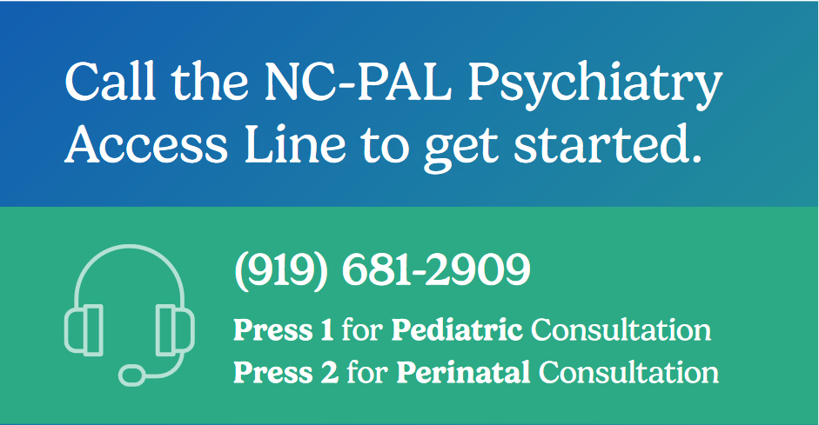
Behavioral health consultant answers the call, collects patient information, and determines how to support the caller’s needs
Pediatric (or perinatal) specialist will call back within 30 minutes, or a time that the caller schedules
Notes:
Across both programs, we have an incredible staff of mental health specialists and behavioral health consultants ready to answer calls.
Our goal is for the patient to remain in the care of their current provider
NC-PAL does not prescribe to patients or provide ongoing care. If the psychiatrist recommends further evaluation, they will schedule the patient for a one-time psychiatric assessment with a member of the NC-PAL team, or will provide a community referral. If treating the patient is beyond the scope of the calling provider, our team will help find resources for the provider to share with the patient.
Callers are able to receive a call back within 30 minutes or at a time of their preference between 8-5 M-F.

Slide 7



What Do We Help With?
Provider receives consultation related to diagnostic and treatment questions
Provider receives resource and referral support for patient
Patient referred for one-time psychiatric assessment to support care planning
Notes:
Examples of questions to call about:

Slide 8

Top 10 Reasons for Pediatric Calls
Medications
Anxiety
Depressed Mood
Behavior Problems
ADHD
Anger/Aggression
Suicidal Ideation
Sleep Problems
Trauma/PTSD
Autism Spectrum Disorder
January 2024

Slide 9
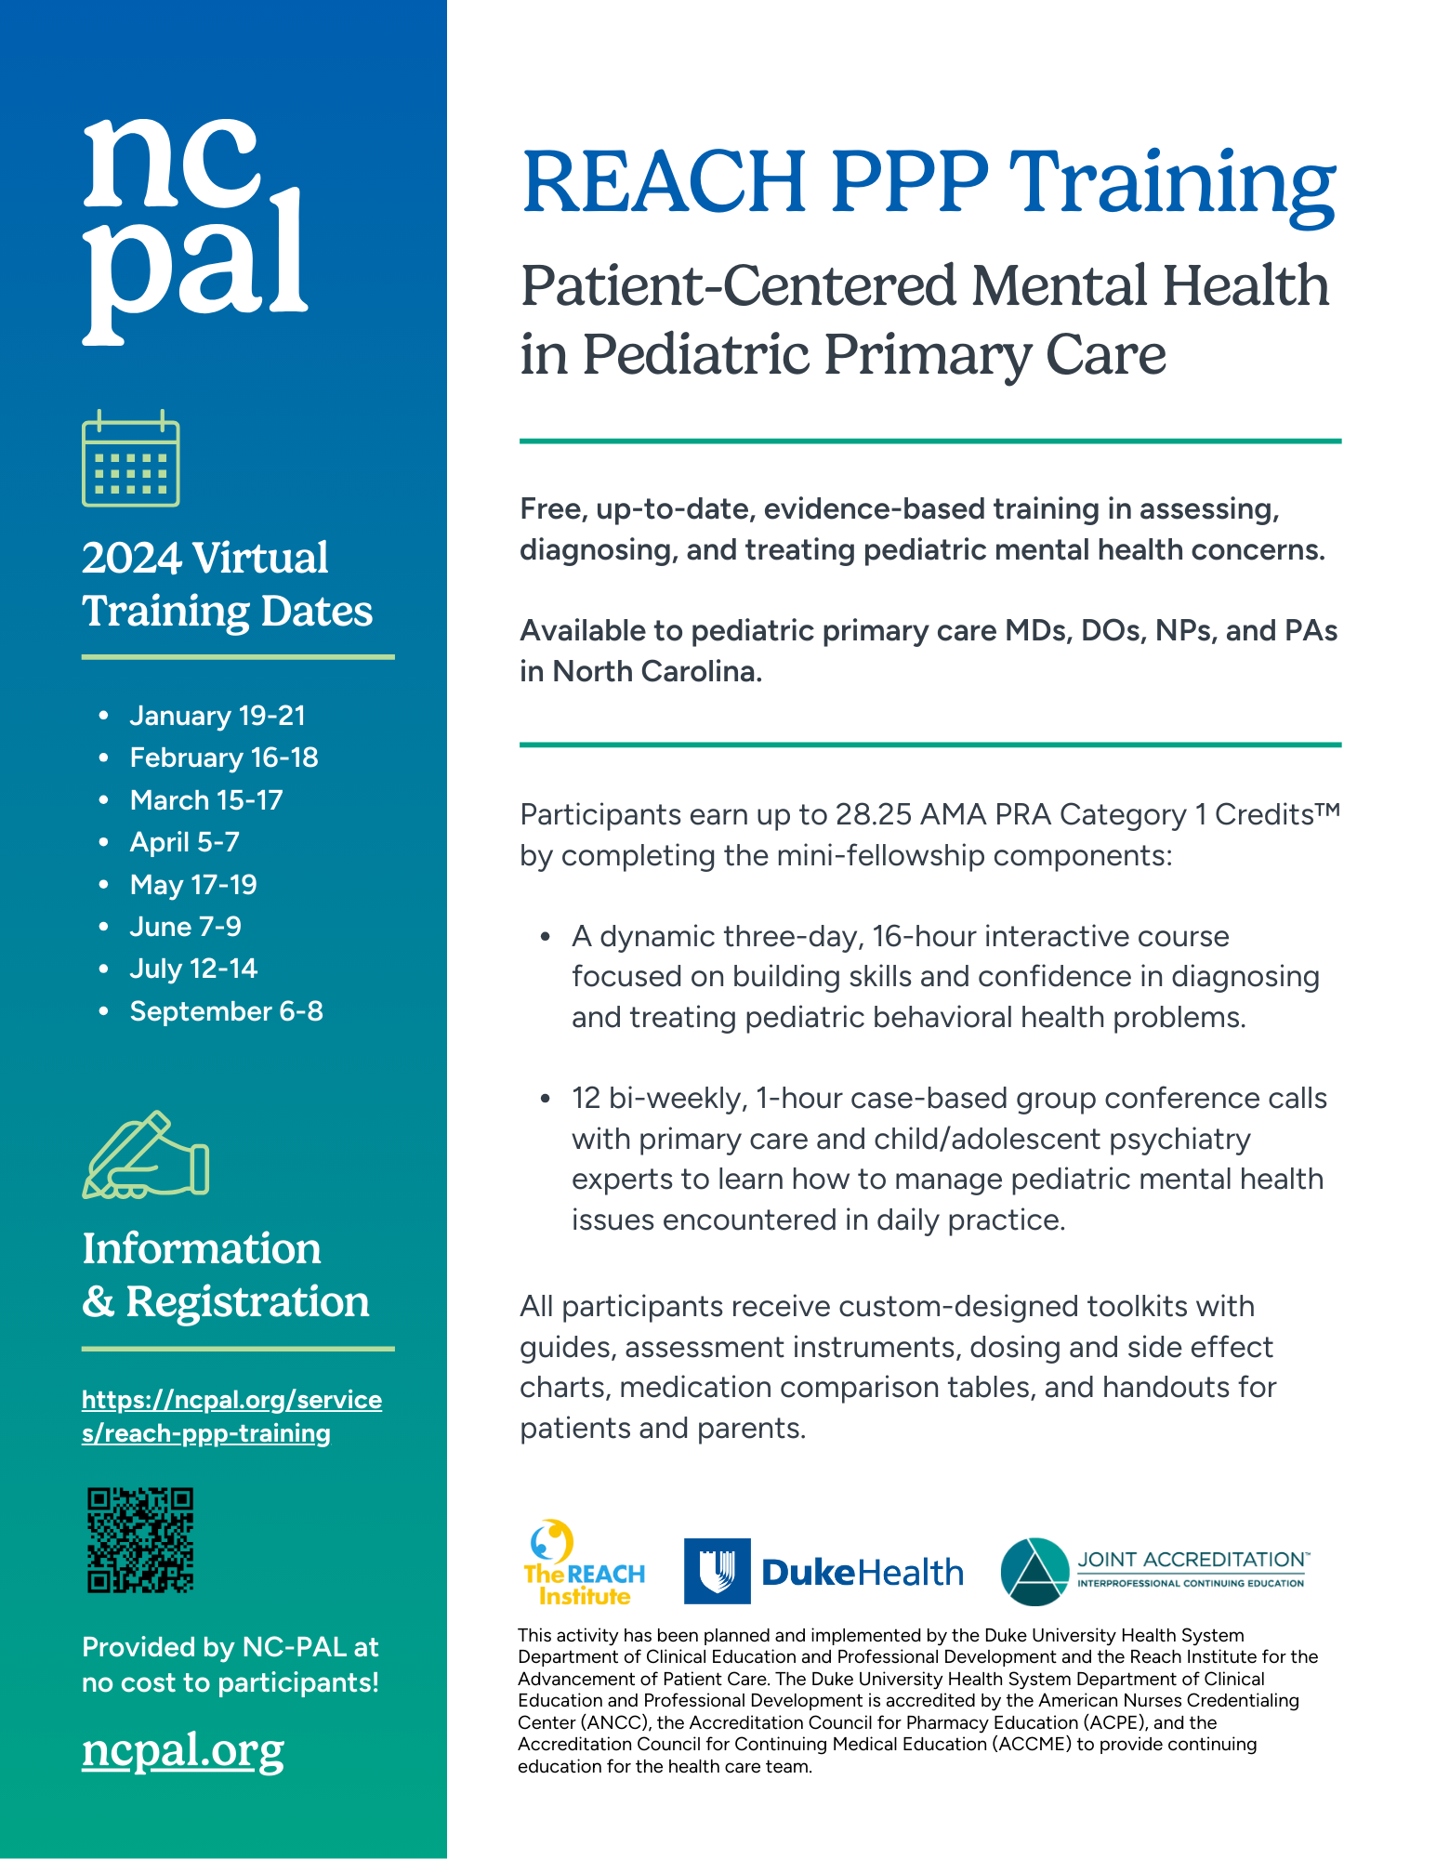
Pediatric Mental Health Training
NC-PAL offers up-to-date, evidence-based training in the diagnosis and treatment of pediatric mental health conditions:
In-depth education and case consultations through REACH PPP Training
Monthly Lunch & Learns
Virtual and in-person presentations to practices
Residency curriculum
  Behavioral Health Expansion in Pediatric Residency Training (Be ExPeRT)

Slide 10
Lunch & Learn Series
Our Lunch & Learn series provides conversations on supporting your patients’ mental health needs.
Each month, an expert speaker will dive into a topic related to screening, diagnosing, treating, and managing the mental health of pediatric and perinatal patients.
To be notified about upcoming sessions, be sure to sign up for NC-PAL’s newsletter!
Upcoming topics include:
Engaging and Partnering with Teens to Address Mental Health Concerns
Eating, Sleeping, & Toileting Concerns in Autism
Types of Therapy
Essential Elements that Guide Therapeutic Work with Latino Families

Slide 11
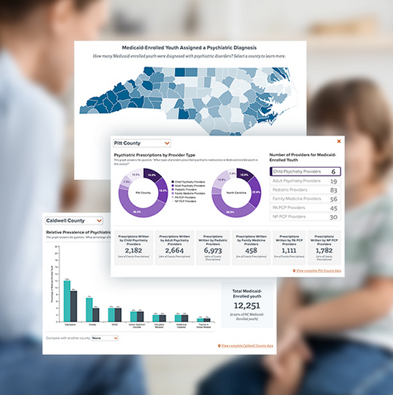
Find more resources at ncpal.org
Notes:
Mention website and share links in the chat it possible:
www.ncpal.org
www.ncmatters.org

Slide 12
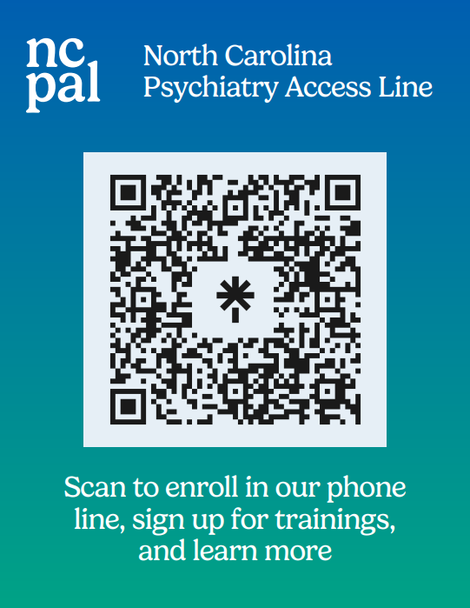
One QR code can let you do 4 things:
Fill out the NC-PAL interest form: 30 seconds
Add NC-PAL to your contacts: 2 seconds
Enroll in NC-PAL: 3 minutes, tops
Sign up for the NC-PAL REACH PPP Training: 3 minutes, tops

Slide 13




The pediatric program is supported by the Health Resources and Services Administration (HRSA) of the U.S. Department of Health and Human Services (HHS) as part of an award totaling $840,000 through September 2026, with 20% financed by a match from NC DHHS.
The perinatal program is supported by the Health Resources and Services Administration (HRSA) of the U.S. Department of Health and Human Services (HHS) as part of an award totaling $4,125,000 through September 2028, with 10% financed by a match from NC DHHS.
With the recent passage of the landmark state budget, NC-PAL is receiving additional funding from Medicaid ($2.4 million) and Mental Health Block Grants ($1.7 million) through June 2024.
The contents are those of the author(s) and do not necessarily represent the official views of, nor an endorsement, by HRSA, HHS or the U.S. Government.
NC Department of Health and Human Services • Division of Public Health • Division of Child and Family Well-Being • www.ncdhhs.gov • NCDHHS is an equal opportunity employer and provider.
Thank you!
Learn more online at ncpal.org
For general information, call us at (919) 660-0341
or send us an email at ncpal@duke.edu
DUMC Box 3527, Durham, NC 27710

